Slide 1
IMDB MOVIE ANALYSIS
Notes:
One of the reason is because our practicum topic is box office forecast and our target variable for that project is basically box office, which is the revenue.
In this project, we want to see whether other variables besides movie revenue would be better standard for predicting the success of a movie. Whether a higher rating better represent a good movie or higher budget would result in a good movie. So we are going to look into that in our analysis.

Slide 2

Models
Python H2O:
Random forest model
Gradient Boosting Machine(GBM)
Neural Network model
Generalized Linear Regression
R:
Multiple Regression
Notes:
We used Python H2O package to run models including Random Forest Model, Gradient Boosting Machine, and Neural Network Model. By running those models, we wanted to identify a few important (influential) variables that can be used as independent variable for our further regression model.
Gradient boosting is a machine learning technique that combines two powerful tools: gradient-based optimization and boosting. Gradient-based optimization uses gradient computations to minimize a model’s loss function in terms of the training data. Boosting additively collects an ensemble of weak models to create a robust learning system for predictive tasks.
http://docs.h2o.ai/h2o/latest-stable/h2o-docs/data-science/gbm.html#interpreting-a-gbm-model
http://docs.h2o.ai/h2o/latest-stable/h2o-docs/data-science/drf.html?highlight=random%20forest#interpreting-a-drf-model
Variable importance is determined by calculating the relative influence of each variable: whether that variable was selected during splitting in the tree building process and how much the squared error (over all trees) improved as a result.

Slide 3
Our Dataset
5000+ movies
28 columns
such as: imdb_score, gross, budget, duration, number of facebook likes
Notes:
First, I’ll walk you through our dataset a little bit, we have 5000 rows of movie scrapped from imdb website, we have 28 columns of different variables such as imdb_socre, gross revenue for the movie, movie budget, movie duration and number of movie facebook page likes. Because we have so many columns, that’s also the reason we want to use Python H2O packages to first identify a few important variable before we run regression. Among those 28, we did data cleaning process to remove null values. And we first pick the columns with numeric values to do some basic data exploration so we can explore the dataset a little bit and identify some interesting variables or relationships

Slide 4
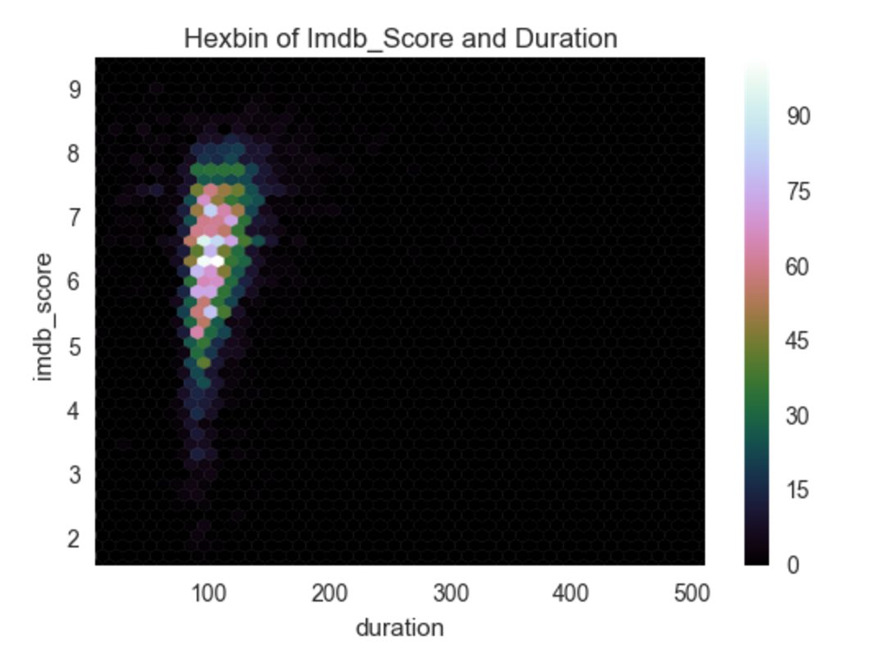
Data Exploration: hexbin plot
Bivariate analogue of histogram
Density instead of points
More straight-forward
Notes:
We pick a few variables that we are interested in and most likely to be significant variable to draw the hexbin plot
The reason why we use hexbin plot instead of scatter plot is because scatter plot is messy and we don’t usually get to see the relationship quickly. Hexbin plots use density other than point, so we get a much more straight forward sense of the relationship between the variables we
are interested in.
By using Hexbin plot, we can easily see the density of data distribution, for example, most of the movie data are score 6.5 and duration around 100 minutes...…
https://www.chrisstucchio.com/blog/2012/dont_use_scatterplots.html
The bivariate analogue of a histogram is known as a “hexbin” plot, because it shows the counts of observations that fall within hexagonal bins.

Slide 5
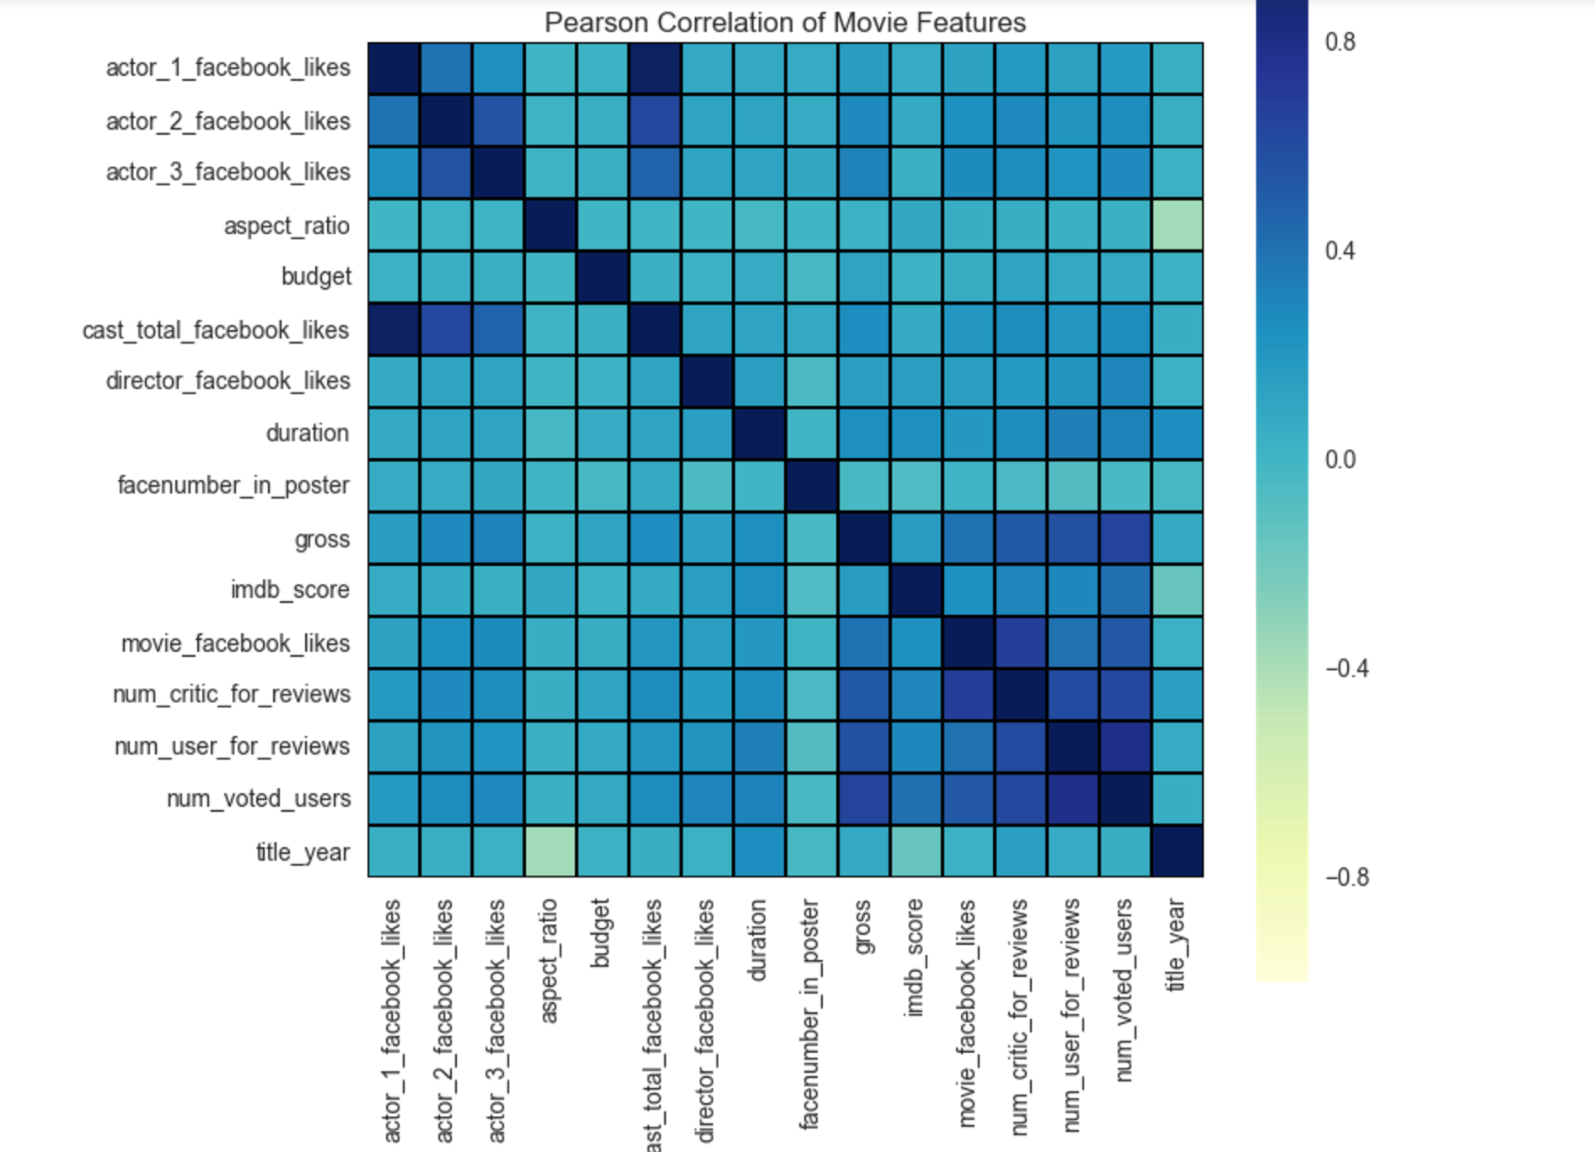
Data Exploration:correlation plot
Notes:
The reason why we want to look at the correlation plots is that we need to take into consideration of multicollinearity when doing multiple regression, we want to avoid multicollinearity as much as possible because multicollinearity may influence the model accuracy and validity.
So by having a correlation plot, we can easily understand which pairs of variables have high correlations and will they become the influential predictors when we do our multiple regressions, that’s something we can keep in mind and look out for.
Also some interesting discovery, we noticed that there is barely significant correlation between imdb_score and gross, see the color, really close to zero, which means the imdb_score and gross are not very correlated, and that is also something we can look into.
One US dollar in 1920 is different from that of 2010. So we need to take inflation factors across years into consideration, and normalize all US dollars into one basis (a certain year).

Slide 6
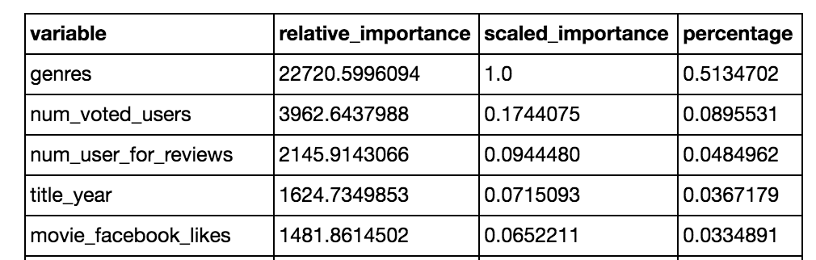
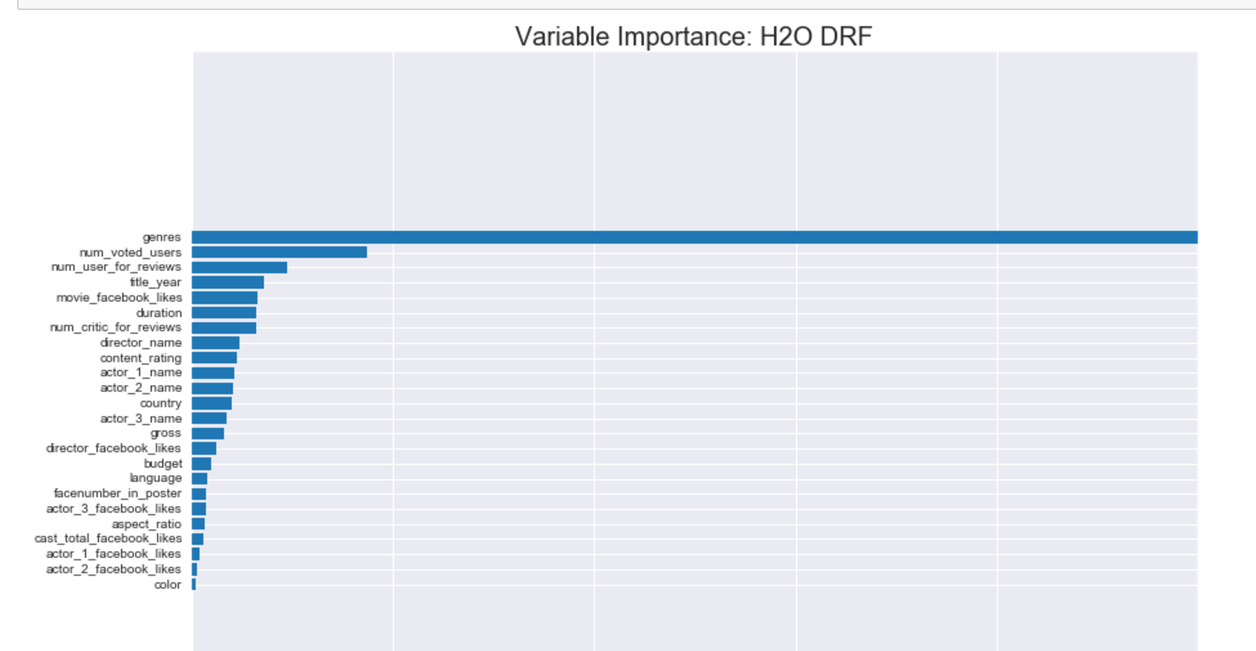
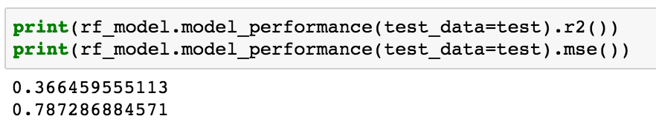
Random Forest Model
(Target: imdb_score)
Notes:
Since we interested in imdb_score for this contest, so we set it as target, as it is a numeric variable, we firstly try Random Forest model to select top 5 important variables and predict. We also split our dataset into 40% training, 30% validation, and 30% test. We use our train data to run the RF model and use test data to predict based on the model.
We developed RF model in python h2o. After modeling, we generate our top 5 predictors to imdb_score, which are genres, number_voted_users, number_user_for_reviews, movie_facebook_likes, title_year. Which meets our common sense. And then lets see how it perform statistically. The r square of this model is 0.3665 and MSE is 0.7873. In reality , this number is decent.
The plot gives us a directly understanding of variable importance, the x-axis is scaled importance and y is column name. The larger scaled importance is, the variable is more important.
RF SETTING:
ntrees=500, # Up to 500 decision trees in the forest
max_depth=30, # trees can grow to depth of 30
stopping_rounds=5, # stop after validation error does not decrease for 5 iterations/new trees
score_each_iteration=True

Slide 7
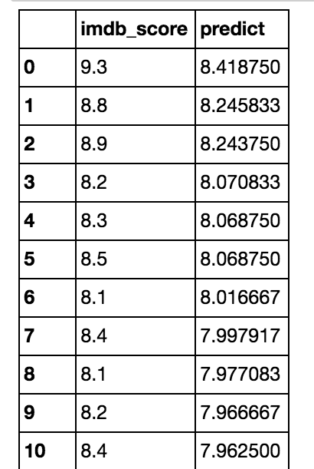
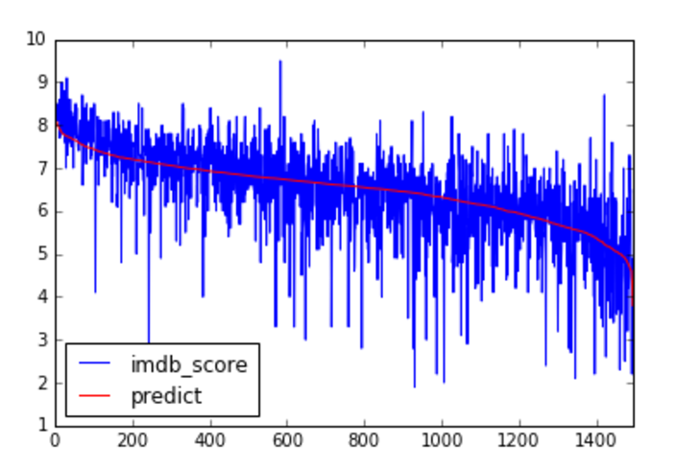
Predictions_RF
(Target: imdb_score)
Notes:
This slide shows how RF prediction perform.s We can see that the red line-predict basically follows the trend of the blue line. Also, we look into the exact value of predictions, it also shows the close value. That tells us the prediction is reliable.

Slide 8
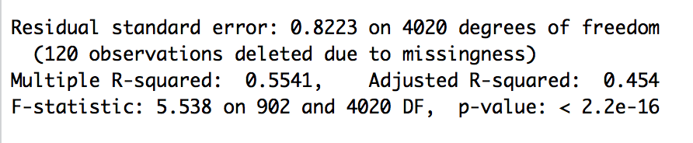
Multiple Regression Result (R)
Notes:
Then, we turned these variables into multiple linear regression in R, which results in adjusted r square of 0.454 and multiple r square of 0.5541.That is not bad and we want to improve it more.

Slide 9
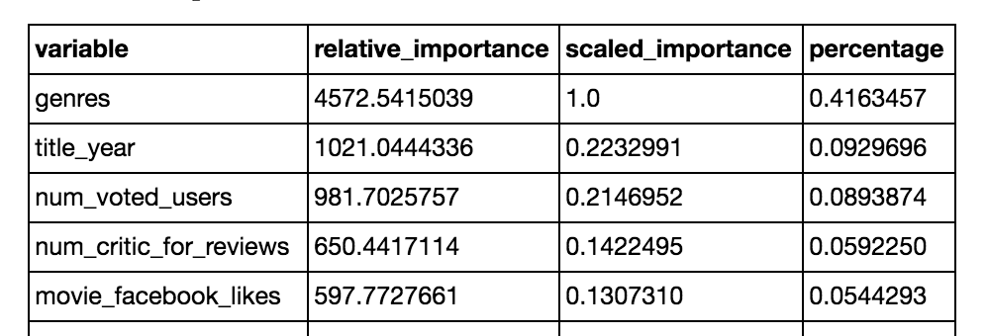
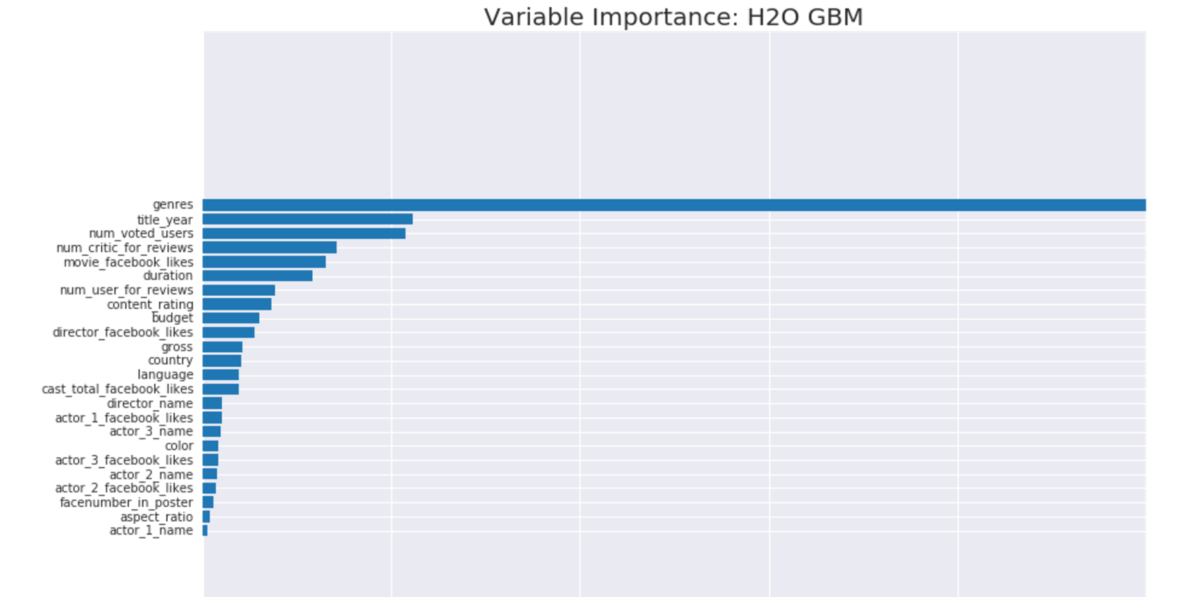
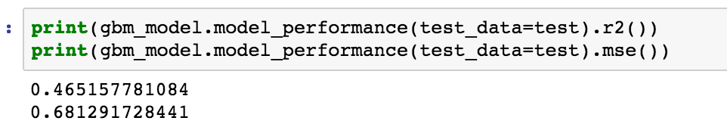
GBM
(Target: imdb_score)
Notes:
Then, we tried GBM to choose variables to see how it works. Other than setting parameters of model manually, we use hyper parameters for gbm to generate several models and automatically output the best model. After modeling, gbm select 5 variables which are genres, number_voted_users, number_critic_for_reviews, title_year, movie_facebook_likes. The r2 of the gbm is 0.4652 and MSE is 0.6813, which are both improved than the RF model.

Slide 10
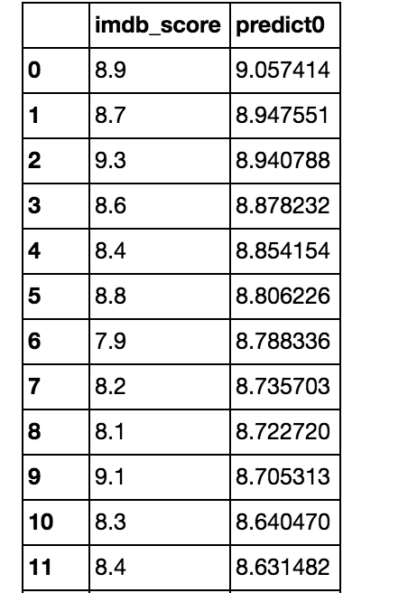
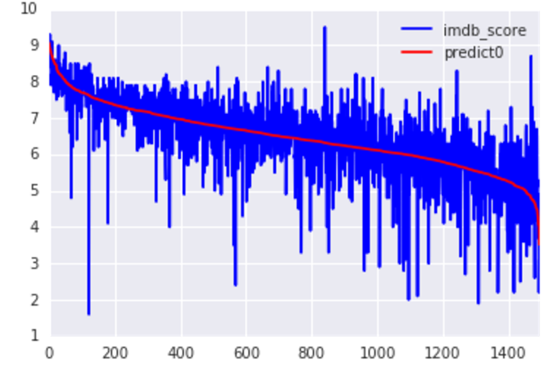
Prediction_GBM
(Target: imdb_score)
Notes:
This slide shows how GBM prediction performs. We can see that the red line-predict basically follows the trend of the blue line. Also, we look into the exact value of predictions, it also shows the close value. That tells us the prediction is reliable.

Slide 11
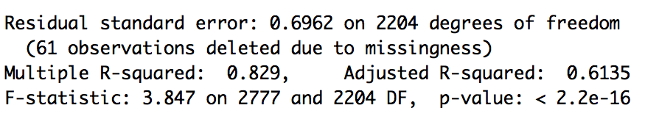
Multiple Regression Result (R)
Notes:
We turn these 5 variables into multiple linear regression and it gives us pretty good r square , where adjusted r square of 0.6135 and multiple r square of 0.829. what a exciting number!

Slide 12
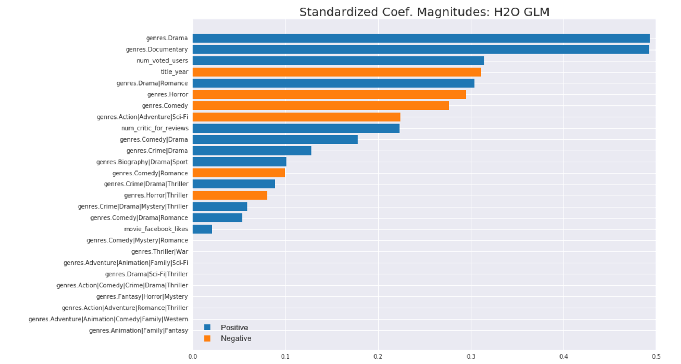
GLR coefficients :
(x from GBM, y = imdb_score)
Notes:
After comparing the statistical results of RF and GBM modeling, we decide to use GBM model’s result. After turned the 5 variables form GBM modeling into generalized linear regression, we can see the coefficient of each variable and have a basic idea of how each variable influences our target variable(positively or negatively).

Slide 13
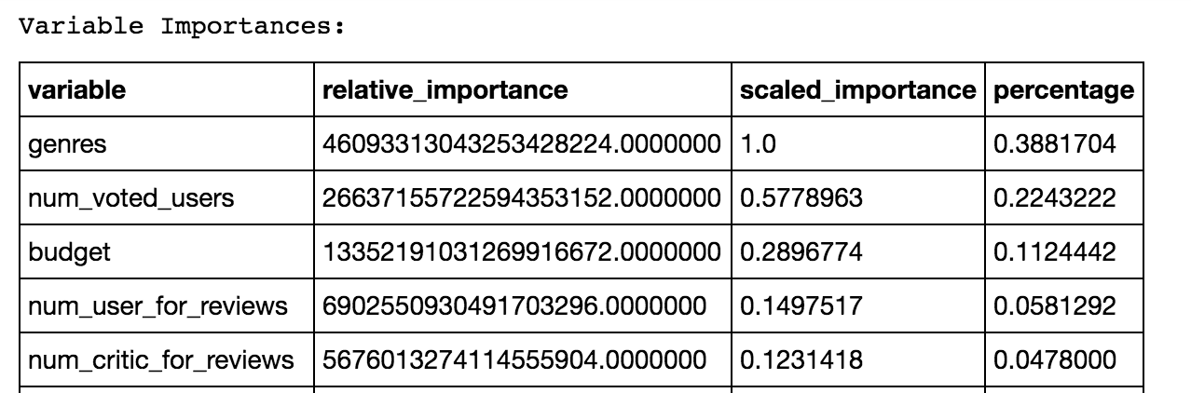
Random Forest & GBM
(Target:gross)
Notes:
Of course, Imdb score is not the only standard to determine if movie is hit, so we change the target variable to gross instead of imdb score to retrain this model.
The GBM and Random forest generates the same top five variables, which is then used to determine if a movie is hit or not. Those variables are: genres, num_voted_users, budget, num_user_for_reviews, num_critic_for_reviews.

Slide 14
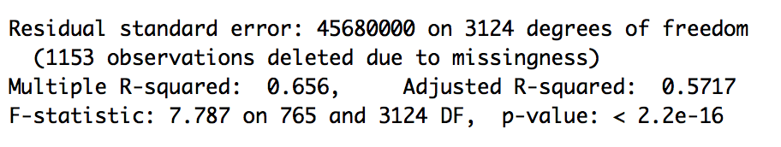
Multiple Regression Result (R)
Notes:
we then put the top five variables that are selected by GBM and randomforest into multiple regression to predict a movie’s gross revenue.
The model shows the R-square is 0.656, which means 65.6% variance in movie’s gross revenue can be predicted by the five independent variables in the sample.
Whereas, 57.17% variance in movie’s gross revenue can be predicted by the five independent variables in the population.
Certainly, the R Square obtained from the model where uses gross revenue is lower than the IMDB model does, thus we think IMDB might be the better indicator to predict a movie given our sample dataset.

Slide 15
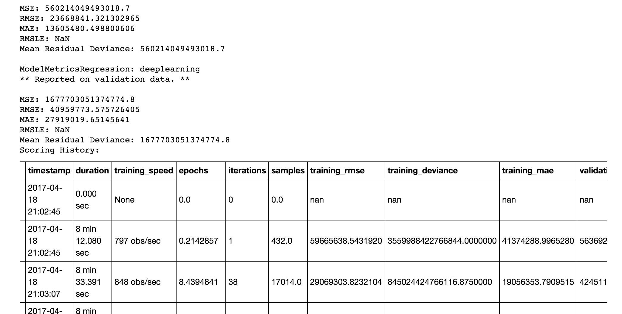
Neural Network Model
R square=0.4162
Notes:
In the previous slide, we agree that we are going to use IMDB score as the target variable to do the prediction.
Besides GBM, Random forest model, we also tried neutral network to see if it is a better fit for our data
The input neuron layer’s size is scaled to the number of input features, so as the number of columns increases, the model complexity increases as well.
train many different NN models with random hyperparameters and select best model based on validation error
NN setting:
epochs=50, # read over the data 50 times, but in mini-batches
hidden=[100], # 100 hidden units in 1 hidden layer
input_dropout_ratio=0.2, # randomly drop 20% of inputs for each iteration, helps w/ generalization
hidden_dropout_ratios=[0.05], # randomly set 5% of hidden weights to 0 each iteration, helps w/ generalization
activation='TanhWithDropout', # bounded activation function that allows for dropout, tanh
l1=0.001, # L1 penalty can help generalization
l2=0.01, # L2 penalty can increase stability in presence of highly correlated inputs
adaptive_rate=True, # adjust magnitude of weight updates automatically (+stability, +accuracy)
stopping_rounds=5, # stop after validation error does not decrease for 5 iterations
score_each_iteration=True, # score validation error on every iteration
model_id='nn_model') # for easy lookup in flow

Slide 16
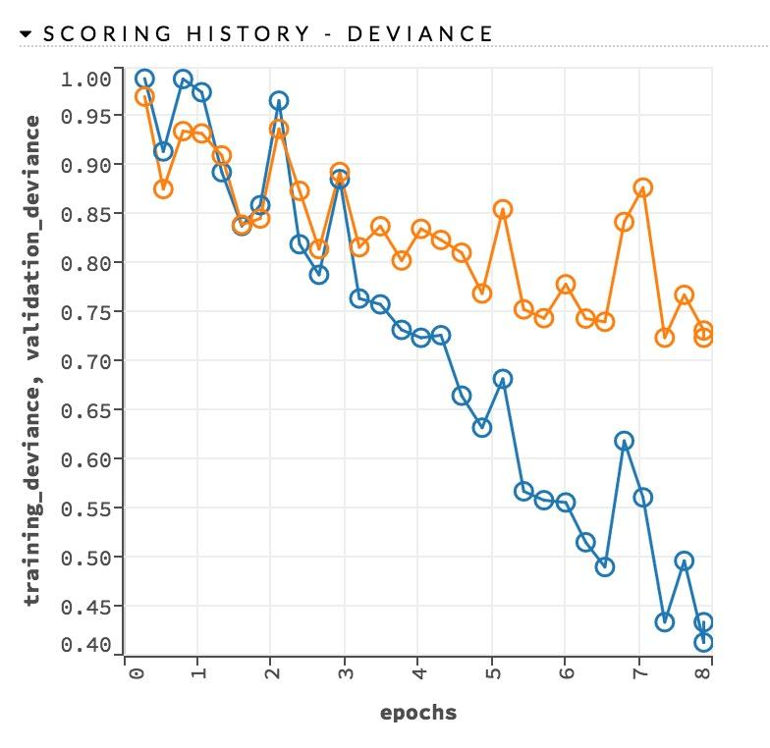
Orange line:
Test Error
Blue line:
Train Error
Notes:
Epochs we set in the NN is 50, which means the model is going to read over the data 50 times
The test error is decreasing as the epochs increases, if the gap is decreasing, then keep on training. However the training stops after epochs since there is no improvement in test error.
The test set error is not decreasing, while your training error is decreasing. One explanation for this situation is that due to overfitting.
Therefore, Neural network does not seem to be a good fit for our data

Slide 17
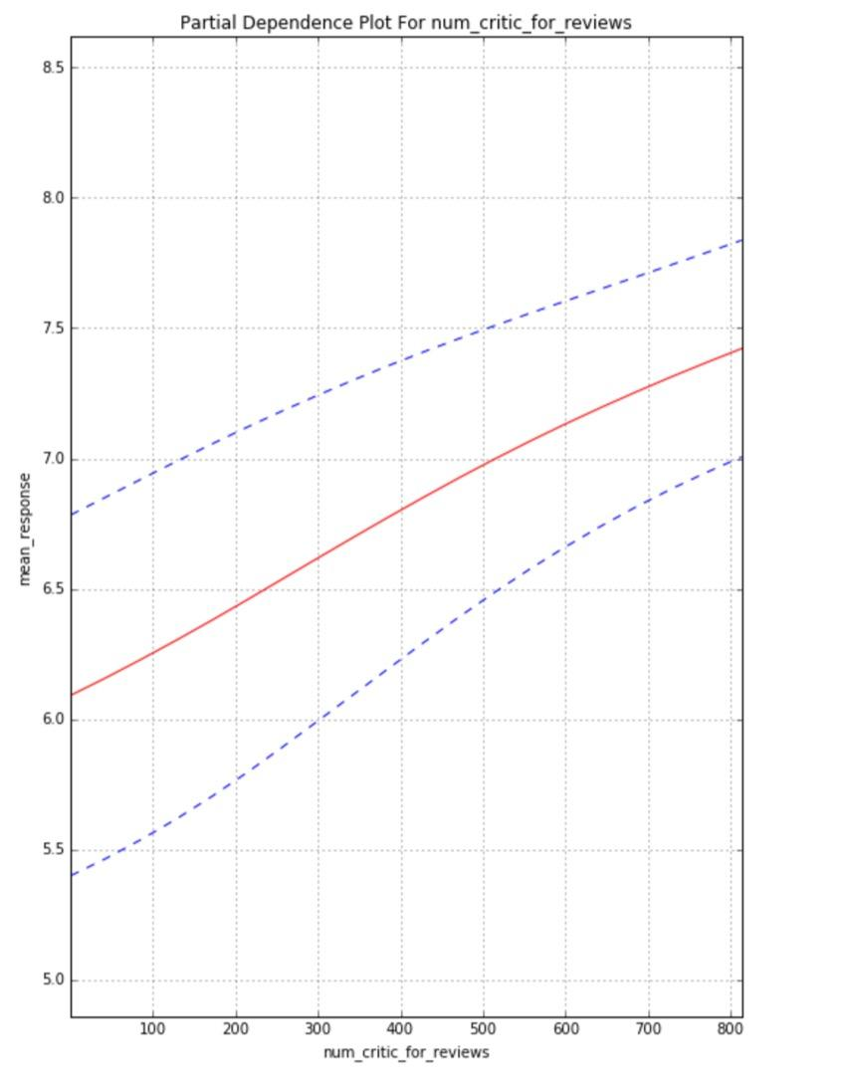
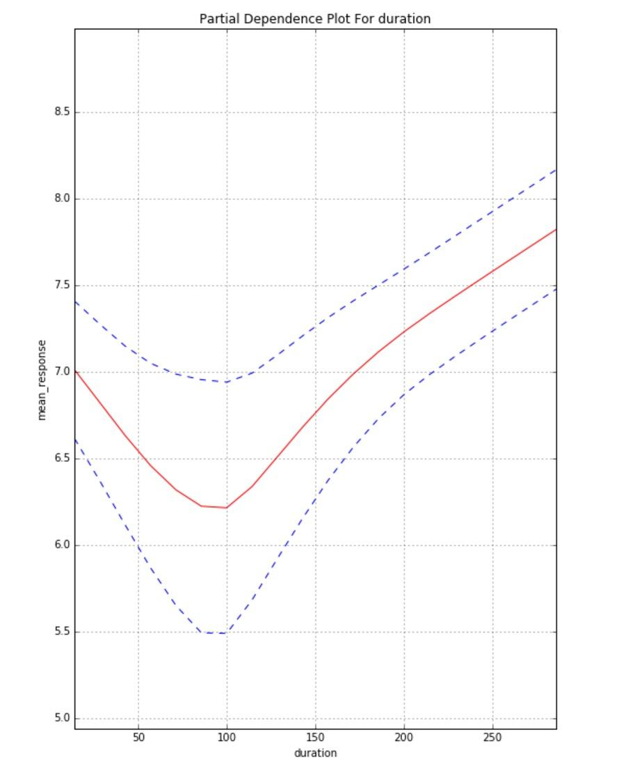
Partial Dependence Plots
Notes:
It can be difficult to understand the functional relations between predictors and an outcome when using random forest and neural network. One way to investigate these relations is with partial dependence plots. Partial dependence plots allow us to visualize interactions among them
Higher y values mean they have a greater influence on accurately predicting the target variable
The graph on the left shows the partial dependence plots between number of critic for reviews and IMDB score, as number of critic for reviews increases, the imdb score is expected to increase.
The graph on the right shows the partial dependence plots between duration and IMDB score. It is interesting to find that when movie duration is less than 100 minutes,the IMDB score is expected to decrease as the duration increases. When the movie duration goes over 100 minutes, the imdb score is expected to increase as the durations increases

Slide 18
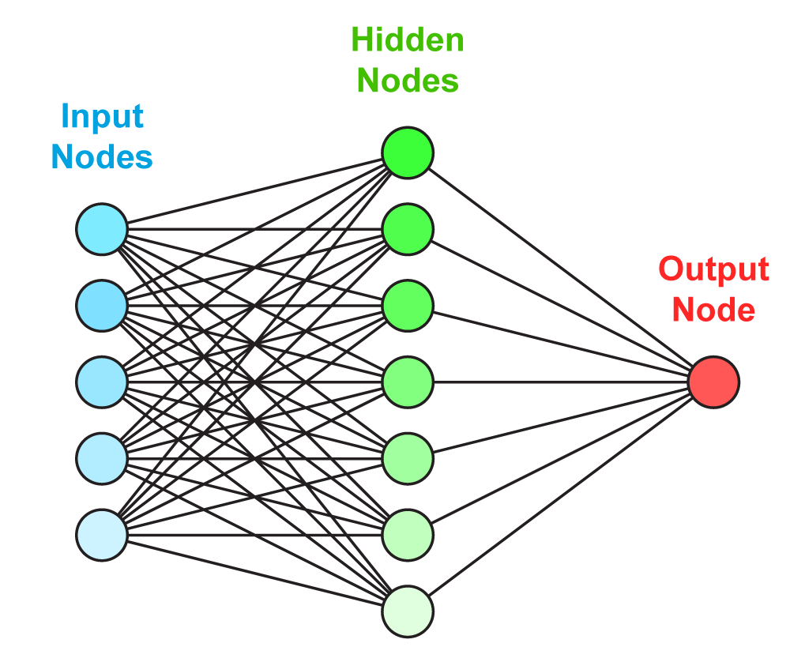
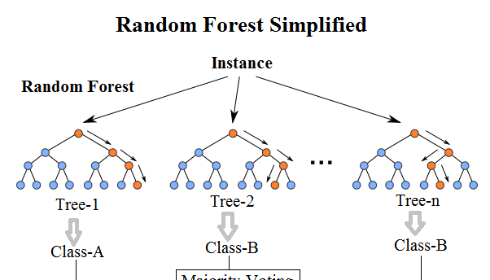
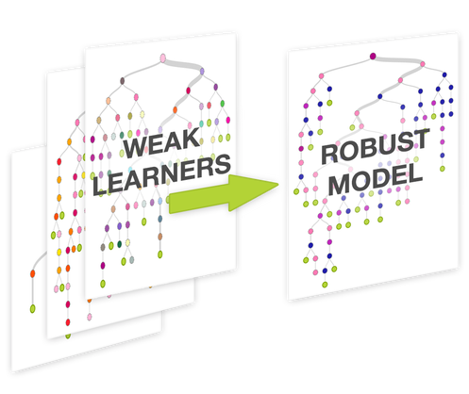
Model Comparisons
r2:0.4652
mse:0.6813
r2:0.3665
mse:0.7873
0.4435
Notes:
As we compared the three models that we have on hand and also take a look with the R square, we found that GBM is the best model that we can use for our dataset. we are going to use imdb_score as the target variables to standard to predict a movie. And the five top significant variable will be genres, no of voted users, no of critics the movie receive, duration of the movie and main actor’s name.
In the future, our next step will be selecting a group of test movie and import them in the R to run the multiple regression, to see the imdb score that our model predicts. and then compare with the actual imdb score that we can find online, to test our model’s accuracy.

Slide 19

Thank you!

